Slide 1
Abstract Classes and Interfaces
Arvind M Bhave

Slide 2
Abstract methods
A method can be prevented from being overridden in the subclass by using the final keyword.
But it is also required that method in the superclass always need to be redefined in the subclass. (for this overridden in necessary).
In such situation super class provides generalized structure of a method and leaves its implementation to its subclass
Java allows to specify a method must always be overridden in the subclass by using keyword abstract in the method declaration.

Slide 3
Abstract methods
You can declare an object without defining it:
  Student s;
Similarly, you can declare a method without defining it:
Syntax for declaring an abstract method
abstract data_type method_name();
Ex.
  public abstract void draw(int size);
  Notice that the body of the method is missing
A method that has been declared but not defined is an abstract method

Slide 4
Abstract classes I
If a class has one or more abstract method must also be declared as abstract (using abstract keyword)
Any class containing an abstract method is an abstract class
Syntax
  abstract class class_name
  {
  abstract data_type method_name();
  ...}

Slide 5
Abstract classes I
You must declare the class with the keyword abstract:
  abstract class MyClass {...}
An abstract class is incomplete
  It has “missing” method bodies
You cannot instantiate (create a new instance of) an abstract class

Slide 6
Abstract classes I
Points to remember
Abstract class cannot be instantiated
Abstract methods of an abstract class must always be implemented in the subclass.
Abstract method must end with semicolon .
There can be both defined and undefined methods in the abstract class
Constructors or static methods cannot be declared as abstract.

Slide 7
Abstract classes II
You can extend (subclass) an abstract class
  If the subclass defines all the inherited abstract methods, it is “complete” and can be instantiated
  If the subclass does not define all the inherited abstract methods, it too must be abstract
You can declare a class to be abstract even if it does not contain any abstract methods
  This prevents the class from being instantiated

Slide 8
Why have abstract classes?
Suppose you wanted to create a class Shape, with subclasses Oval, Rectangle, Triangle, Hexagon, etc.
You don’t want to allow creation of a “Shape”
  Only particular shapes make sense, not generic ones
  If Shape is abstract, you can’t create a new Shape
  You can create a new Oval, a new Rectangle, etc.
Abstract classes are good for defining a general category containing specific, “concrete” classes

Slide 9
An example abstract class
public abstract class Animal {
abstract int eat();
abstract void breathe();
}
This class cannot be instantiated
Any non-abstract subclass of Animal must provide the eat() and breathe() methods

Slide 10
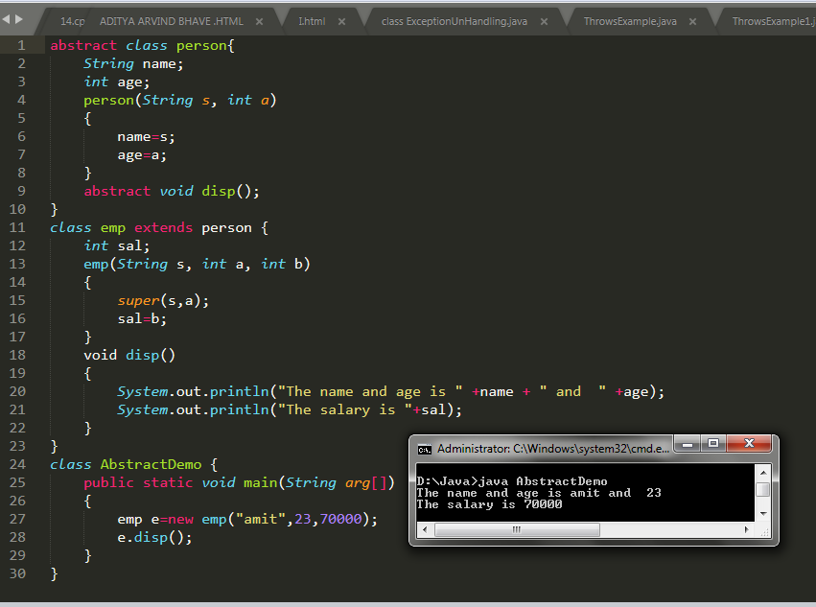
Program

Slide 11
Why have abstract methods?
Suppose you have a class Shape, but it isn’t abstract
  Shape should not have a draw() method
  Each subclass of Shape should have a draw() method
Now suppose you have a variable Shape figure; where figure contains some subclass object (such as a Star)
  It is a syntax error to say figure.draw(), because the Java compiler can’t tell in advance what kind of value will be in the figure variable
  A class “knows” its superclass, but doesn’t know its subclasses
  An object knows its class, but a class doesn’t know its objects
Solution: Give Shape an abstract method draw()
  Now the class Shape is abstract, so it can’t be instantiated
  The figure variable cannot contain a (generic) Shape, because it is impossible to create one
  Any object (such as a Star object) that is a (kind of) Shape will have the draw() method
  The Java compiler can depend on figure.draw() being a legal call and does not give a syntax error

Slide 12
A problem
class Shape { ... }
class Star extends Shape {
void draw() { ... }
...
}
class Crescent extends Shape {
void draw() { ... }
...
}
Shape someShape = new Star();
  This is legal, because a Star is a Shape
someShape.draw();
  This is a syntax error, because some Shape might not have a draw() method
  Remember: A class knows its superclass, but not its subclasses

Slide 13
A solution
abstract class Shape {
void draw();
}
class Star extends Shape {
void draw() { ... }
...
}
class Crescent extends Shape {
void draw() { ... }
...
}
Shape someShape = new Star();
  This is legal, because a Star is a Shape
  However, Shape someShape = new Shape(); is no longer legal
someShape.draw();
  This is legal, because every actual instance must have a draw() method

Slide 14
Interface
Java doesn’t support Multiple Inheritance
Java can not have more than one super class.
Java can achieve multiple inheritance through Interface.
Interface is a collection of methods declaration and constants that one or more classes of object will use.
Interface is a blueprint of class
The interface in Java is a mechanism to achieve abstraction.
There can be only abstract methods in the Java interface, not method body.
It is used to achieve abstraction and multiple inheritance in Java.
In other words, you can say that interfaces can have abstract methods and variables. It cannot have a method body.

Slide 15
Interface
An interface is a fully abstract class
A class can implement number of interfaces
Syntax
[access_specifier] interface <interface_name>
{
return_type method 1(arg list);
…
return_type method n(arg list);
type final-variable 1=value;
……
type final-variable n=value;
}

Slide 16
Interfaces
An interface declares (describes) methods but does not supply bodies for them
interface KeyListener {
public void keyPressed(KeyEvent e);
public void keyReleased(KeyEvent e);
public void keyTyped(KeyEvent e);
}
All the methods are implicitly public and abstract
  You can add these qualifiers if you like, but why bother?
You cannot instantiate an interface
  An interface is like a very abstract class—none of its methods are defined
An interface may also contain constants (final variables)

Slide 17
Designing interfaces
Most of the time, you will use Sun-supplied Java interfaces
Sometimes you will want to design your own
You would write an interface if you want classes of various types to all have a certain set of capabilities
For example, if you want to be able to create animated displays of objects in a class, you might define an interface as:
  public interface Animatable {
  install(Panel p);
  display();
  }
Now you can write code that will display any Animatable class in a Panel of your choice, simply by calling these methods

Slide 18
Implementing an interface I
You extend a class, but you implement an interface
A class can only extend (subclass) one other class, but it can implement as many interfaces as you like
Example:
  class MyListener
  implements KeyListener, ActionListener { … }

Slide 19
Implementing an interface II
When you say a class implements an interface, you are promising to define all the methods that were declared in the interface
Example:
class MyKeyListener implements KeyListener {
public void keyPressed(KeyEvent e) {...};
public void keyReleased(KeyEvent e) {...};
public void keyTyped(KeyEvent e) {...};
}
  The “...” indicates actual code that you must supply
Now you can create a new MyKeyListener

Slide 20
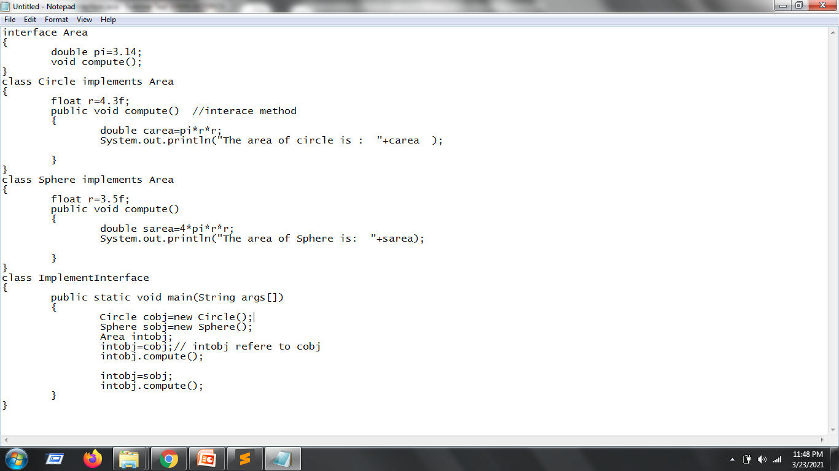

Slide 21

Interface
interface Printable{
void print();
}
interface Showable{
void show();
}
class InterfaceDemo implements Printable,Showable{
public void print(){System.out.println("Hello");}
public void show(){System.out.println("Welcome");}
public static void main(String args[]){
InterfaceDemo obj = new InterfaceDemo();
obj.print();
obj.show();
}
}

Slide 22
Partially implementing an Interface
It is possible to define some but not all of the methods defined in an interface:
abstract class MyKeyListener implements KeyListener {
public void keyTyped(KeyEvent e) {...};
}
Since this class does not supply all the methods it has promised, it is an abstract class
You must label it as such with the keyword abstract
You can even extend an interface (to add methods):
  interface FunkyKeyListener extends KeyListener { ... }

Slide 23
What are interfaces for?
Reason 1: A class can only extend one other class, but it can implement multiple interfaces
  This lets the class fill multiple “roles”
  In writing Applets, it is common to have one class implement several different listeners
  Example:
  class MyApplet extends Applet
  implements ActionListener, KeyListener {
  ...
  }
Reason 2: You can write methods that work for more than one kind of class

Slide 24
How to use interfaces
You can write methods that work with more than one class
interface RuleSet { boolean isLegal(Move m, Board b);
void makeMove(Move m); }
  Every class that implements RuleSet must have these methods
class CheckersRules implements RuleSet { // one implementation
public boolean isLegal(Move m, Board b) { ... }
public void makeMove(Move m) { ... }
}
class ChessRules implements RuleSet { ... } // another implementation
class LinesOfActionRules implements RuleSet { ... } // and another
RuleSet rulesOfThisGame = new ChessRules();
  This assignment is legal because a rulesOfThisGame object is a RuleSet object
if (rulesOfThisGame.isLegal(m, b)) { makeMove(m); }
  This statement is legal because, whatever kind of RuleSet object rulesOfThisGame is, it must have isLegal and makeMove methods

Slide 25
instanceof
instanceof is a keyword that tells you whether a variable
“is a” member of a class or interface
For example, if
  class Dog extends Animal implements Pet {...}
  Animal fido = new Dog();
then the following are all true:
  fido instanceof Dog
  fido instanceof Animal
  fido instanceof Pet
instanceof is seldom used
  When you find yourself wanting to use instanceof, think about whether the method you are writing should be moved to the individual subclasses

Slide 26
Interfaces, again
When you implement an interface, you promise to define all the functions it declares
There can be a lot of methods
  interface KeyListener {
  public void keyPressed(KeyEvent e);
  public void keyReleased(KeyEvent e);
  public void keyTyped(KeyEvent e);
  }
What if you only care about a couple of these methods?

Slide 27
Adapter classes
Solution: use an adapter class
An adapter class implements an interface and provides empty method bodies
class KeyAdapter implements KeyListener {
public void keyPressed(KeyEvent e) { };
public void keyReleased(KeyEvent e) { };
public void keyTyped(KeyEvent e) { };
}
You can override only the methods you care about
This isn’t elegant, but it does work
Java provides a number of adapter classes

Slide 28
Vocabulary
abstract method—a method which is declared but not defined (it has no method body)
abstract class—a class which either (1) contains abstract methods, or (2) has been declared abstract
instantiate—to create an instance (object) of a class
interface—similar to a class, but contains only abstract methods (and possibly constants)
adapter class—a class that implements an interface but has only empty method bodies

Slide 29
The End

